Slide 1
IPv6: Are we really ready to turn off IPv4?

Slide 2
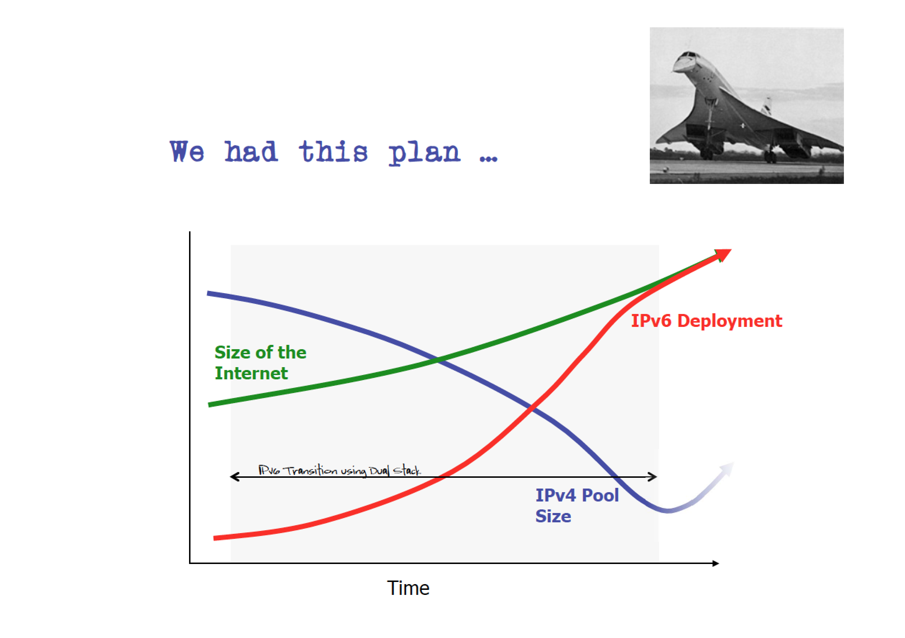
In-situ transition…

Slide 3
In-situ transition…
Phase 1 – Early Deployment
IPv4 Internet
Edge Dual-Stack Networks
IPv6 networks interconnect by
IPv6-over-IPv4 tunnels

Slide 4
In-situ transition…
Phase 2 – Dual Stack Deployment
Transit Dual-Stack
Networks
Edge Dual-Stack
Networks
IPv6 networks interconnect by
Dual Stack transit paths

Slide 5
In-situ transition…
Phase 3 – IPv4 Sunset
IPv6 Internet
Edge Dual-Stack Networks
IPv4 networks interconnect by
IPv4-over-IPv6 tunnels

Slide 6
We are currently in Phase 2 of this transition
Some 15% to 20% of Internet users have IPv6 capability
Most new IP deployments rely on NATS and IPv4 (and may, or may not,
also have IPv6)
IPv4-only Legacy networks are being slowly migrated to dual stack

Slide 7
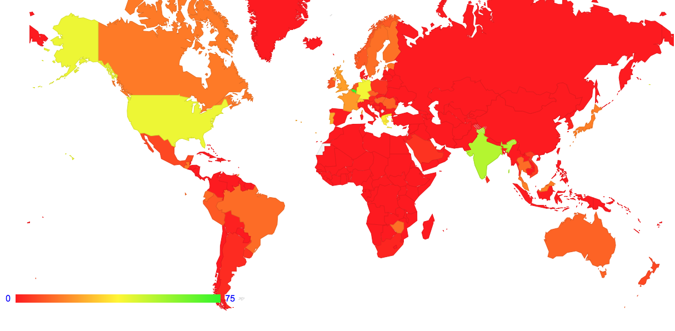
The Map of IPv6 penetration – August 2017

Slide 8
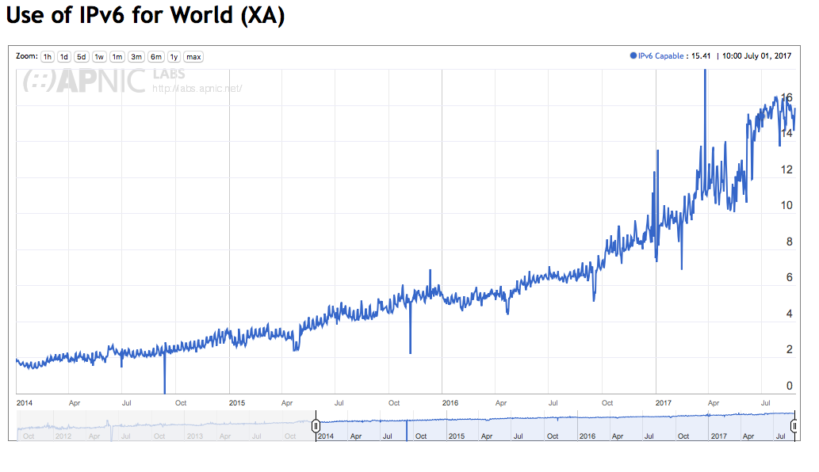
The Map of IPv6 penetration – August 2017

Slide 9
We are currently in Phase 2 of this transition
Some 15% of Internet users have IPv6 capability
Most new IP deployments use IPv6
IPv4-only Legacy networks are being (gradually) migrated to dual stack
The current situation is that the universal “glue” of the Internet remains IPv4, while IPv6 is still an optional feature!

Slide 10
Today
We appear to be in the middle of the transition!
Dual Stack networks cannot drop support for IPv4 as long as significant services and user populations do not support IPv6 – and we can’t tell when that may change
Nobody is really in a position to deploy a robust at-scale ipv6-only network service today, even if they wanted to!
And we are not even sure if we can!

Slide 11
Today
We appear to be in the middle of the transition!
Dual Stack networks cannot drop support for IPv4 as long as significant services and user populations do not support IPv6 – and we can’t tell when that may change
Nobody is really in a position to deploy a robust at-scale ipv6-only network service today, even if they wanted to!
And we are not even sure if we can!

Slide 12
The Issue
  We cannot run Dual-Stack services indefinitely
  At some point we need to support networks that only have IPv6
  Is that viable?

Slide 13
In other words…
What do we rely on today in IPv4 that does not appear to have a clear working counterpart in IPv6?
If the answer is “nothing” then we are done!
But if there are issues here, then we should be working on it!

Slide 14
IPv6: What changed?
Type of Service is changed to Traffic Class
Flow Label Added
Options and Protocol fields replaced by Extension Headers
32 bit Fragmentation Control were pushed into an Extension Header
Checksum becomes a media layer function
The substantive change with IPv6 is the handling of fragmentation and the use of Extension Headers

Slide 15
IPv6: What changed?
IPv4 “Forward Fragmentation”
IPv4 header
2
IPv4 header
1
TCP/UDP header
TCP/UDP header
Payload
Payload
IPv4 Router

Slide 16
IPv6: What changed?
IPv4 “Forward Fragmentation”
IPv4 header
2
IPv4 header
1
TCP/UDP header
TCP/UDP header
Payload
Payload
Source
IPv4 Router
IPv6 header
TCP/UDP xtn header
IPv6 “Source Fragmentation”
1
Payload
IPv6 Router
Source
ICMPv6 PTB
IPv6 header
2
TCP/UDP xtn header
Payload
IPv6 header
Fragmentation xtn header
3
TCP/UDP xtn header
Payload

Slide 17
New Dependencies
For IP fragmentation to work in IPv6 then:
- all ICMPv6 messages have to be passed backwards from the interior
of the network to the sender
- IPv6 packets containing a IPv6 Fragmentation Extension
header should not be dropped

Slide 18
ICMPv6
Only the sending host now has control of fragmentation – this is a new twist
A received ICMPv6 message needs to alter the sender’s state to that destination:
For TCP, if the ICMP payload contains the TCP header, then you can pass this to the TCP control block. TCP can alter the session MSS and resend the dropped data, or you can just alter the local per-destination MSS and hope that TCP will be prompted to resend
For UDP – um, err, um well
Maybe you should store the revised path MTU in a host forwarding table cache for a while
If you ever need to send another UDP packet to this host you can use this cache entry to guide your fragmentation behaviour

Slide 19
ICMPv6 and Anycast
Anycast Constellation
Sender Instance
Sender Instance
Client
Sender Instance
Sender Instance
Sender Instance
It is not obvious (or even assured) that every router on the path from an anycast instance to a client host will necessarily be part of the same anycast instance “cloud”
The implication is that in anycast, the reverse ICMPv6 PTB messages will not necessarily head back to the original sender!

Slide 20
IPv6 Fragmentation Extension Header Handling
The extension header sits between the IPv6 packet header and the upper level protocol header for the leading fragged packet, and sits between the header and the trailing payload frags for the trailing packets
Practically, this means that transport-protocol aware packet processors/switches need to decode the extension header chain, if its present, which can consume additional cycles to process/switch a packet – and the additional time is not predictable. For trailing frags there is no transport header!
Or the unit can simply discard all Ipv6 packets that contain extension headers!
Which is what a lot of transport protocol sensitive IPv6 deployed switching equipment actually does (e.g. load balancers!)
IPv6 header
Fragmentation xtn header
TCP/UDP xtn header
Payload

Slide 21
IPv6 Fragmentation Extension Header Handling
There is a lot of “drop” behaviour in the Ipv6 Internet for Fragmentation Extension headers
RFC7872 – recorded EH packet drop rates of 30% - 40%
This experiment sent fragmented packets towards well-known servers and observed whether the server received and reconstructed the fragmented packet
But sending fragmented queries to servers is not all that common – the reverse situation of big responses is more common
So what about sending fragmented packets BACK from servers – what’s the drop rate of the reverse case?

Slide 22
IPv6 Fragmentation Extension Header Handling
We used an ad-based measurement system, using a custom packet fragmentation wrangler as a front end to a DNS and Web server to test IPv6 fragmentation behaviour
DNS Resolver
IPv6 DNS Server
IPv6 ‘Fragmenter’
DNS Goo
IPv6 NGINX Server
Client

Slide 23
IPv6 Fragmentation Extension Header Handling
We used an ad-based measurement system, using a custom packet fragmentation wrangler as a front end to a DNS and Web server to test IPv6 fragmentation behaviour
We use a technique of “glueless” delegation and fragmentation of the NS query response to allow us to detect if the DNS resolver received the fragmented response
DNS Resolver
DNS Resolver
IPv6 DNS Server
IPv6 ‘Fragmenter’
DNS Goo
IPv6 NGINX Server
Client
Client
We track TCP ACKs at the server to see if the client received the fragmented TCP response

Slide 24
IPv6 Fragmentation Extension Header Handling
Our experiments across some 40M individual sample points:
  37% of end users who used IPv6-capable DNS resolvers could not receive a fragmented IPv6 response
  20% of IPv6-capable end users could not receive a fragmented IPv6 packet

Slide 25
IPv6 Fragmentation is very unreliable
Why don’t we see this unreliability in today’s IPv6 networks affecting user transactions?
Because IPv4 papers over the problem!
In a Dual-Stack environment there is always the option to flip to use IPv4 if you are stuck with Ipv6.
  The DNS does this, and Happy Eyeballs does this
So there is no user-visible problem in a dual stack environment
This means that there is no urgent imperative to correct these underlying problems in deployed IPv6 networks
There is little in the way of practical incentives to fix this today!

Slide 26
Living without IPv6 Fragmentation
If we apparently don’t want to fix this, can we live with it?
We are living with it in a Dual Stack world, because Ipv4 just makes it all better!
But what happens when there is no Ipv4 left?
We have to avoid IPv6 Fragmentation!
TCP can work as long as IPv6 sessions use conservative MSS sizes
UDP can work as long as UDP packet sizes are capped so as to avoid fragmentation
Who needs to use large UDP packets anyway?
DNSSEC!

Slide 27
Where are we?
In terms of protocol support and reliability, It seems that we are mostly ready for an IPv6-only environment, with the one exception of IPv6 packet fragmentation handling.
The consequence is that today’s environment cannot support an Ipv6-only environment for the DNS, and DNSSEC in particular
Change the deployed IPv6 network and change deployed vendor equipment to correctly manage fragmentation, and stop using anycast!
Change host configurations and change protocol behaviours to avoid any reliance at all on correct handling of packet fragmentation

Slide 28
An IPv6-only Internet?
The issue of the unreliability of IPv6 fragmentation is a significant issue.
These mitigation approaches represent significant effort and cost
Effort and cost that is unnecessary for as long as IPv4 can paper over the problem!
So we are taking the easy option, and collectively we are doing nothing at all!
Maybe if we close our eyes long enough all this will just go away!

Slide 29
Thanks!

